Slide 1
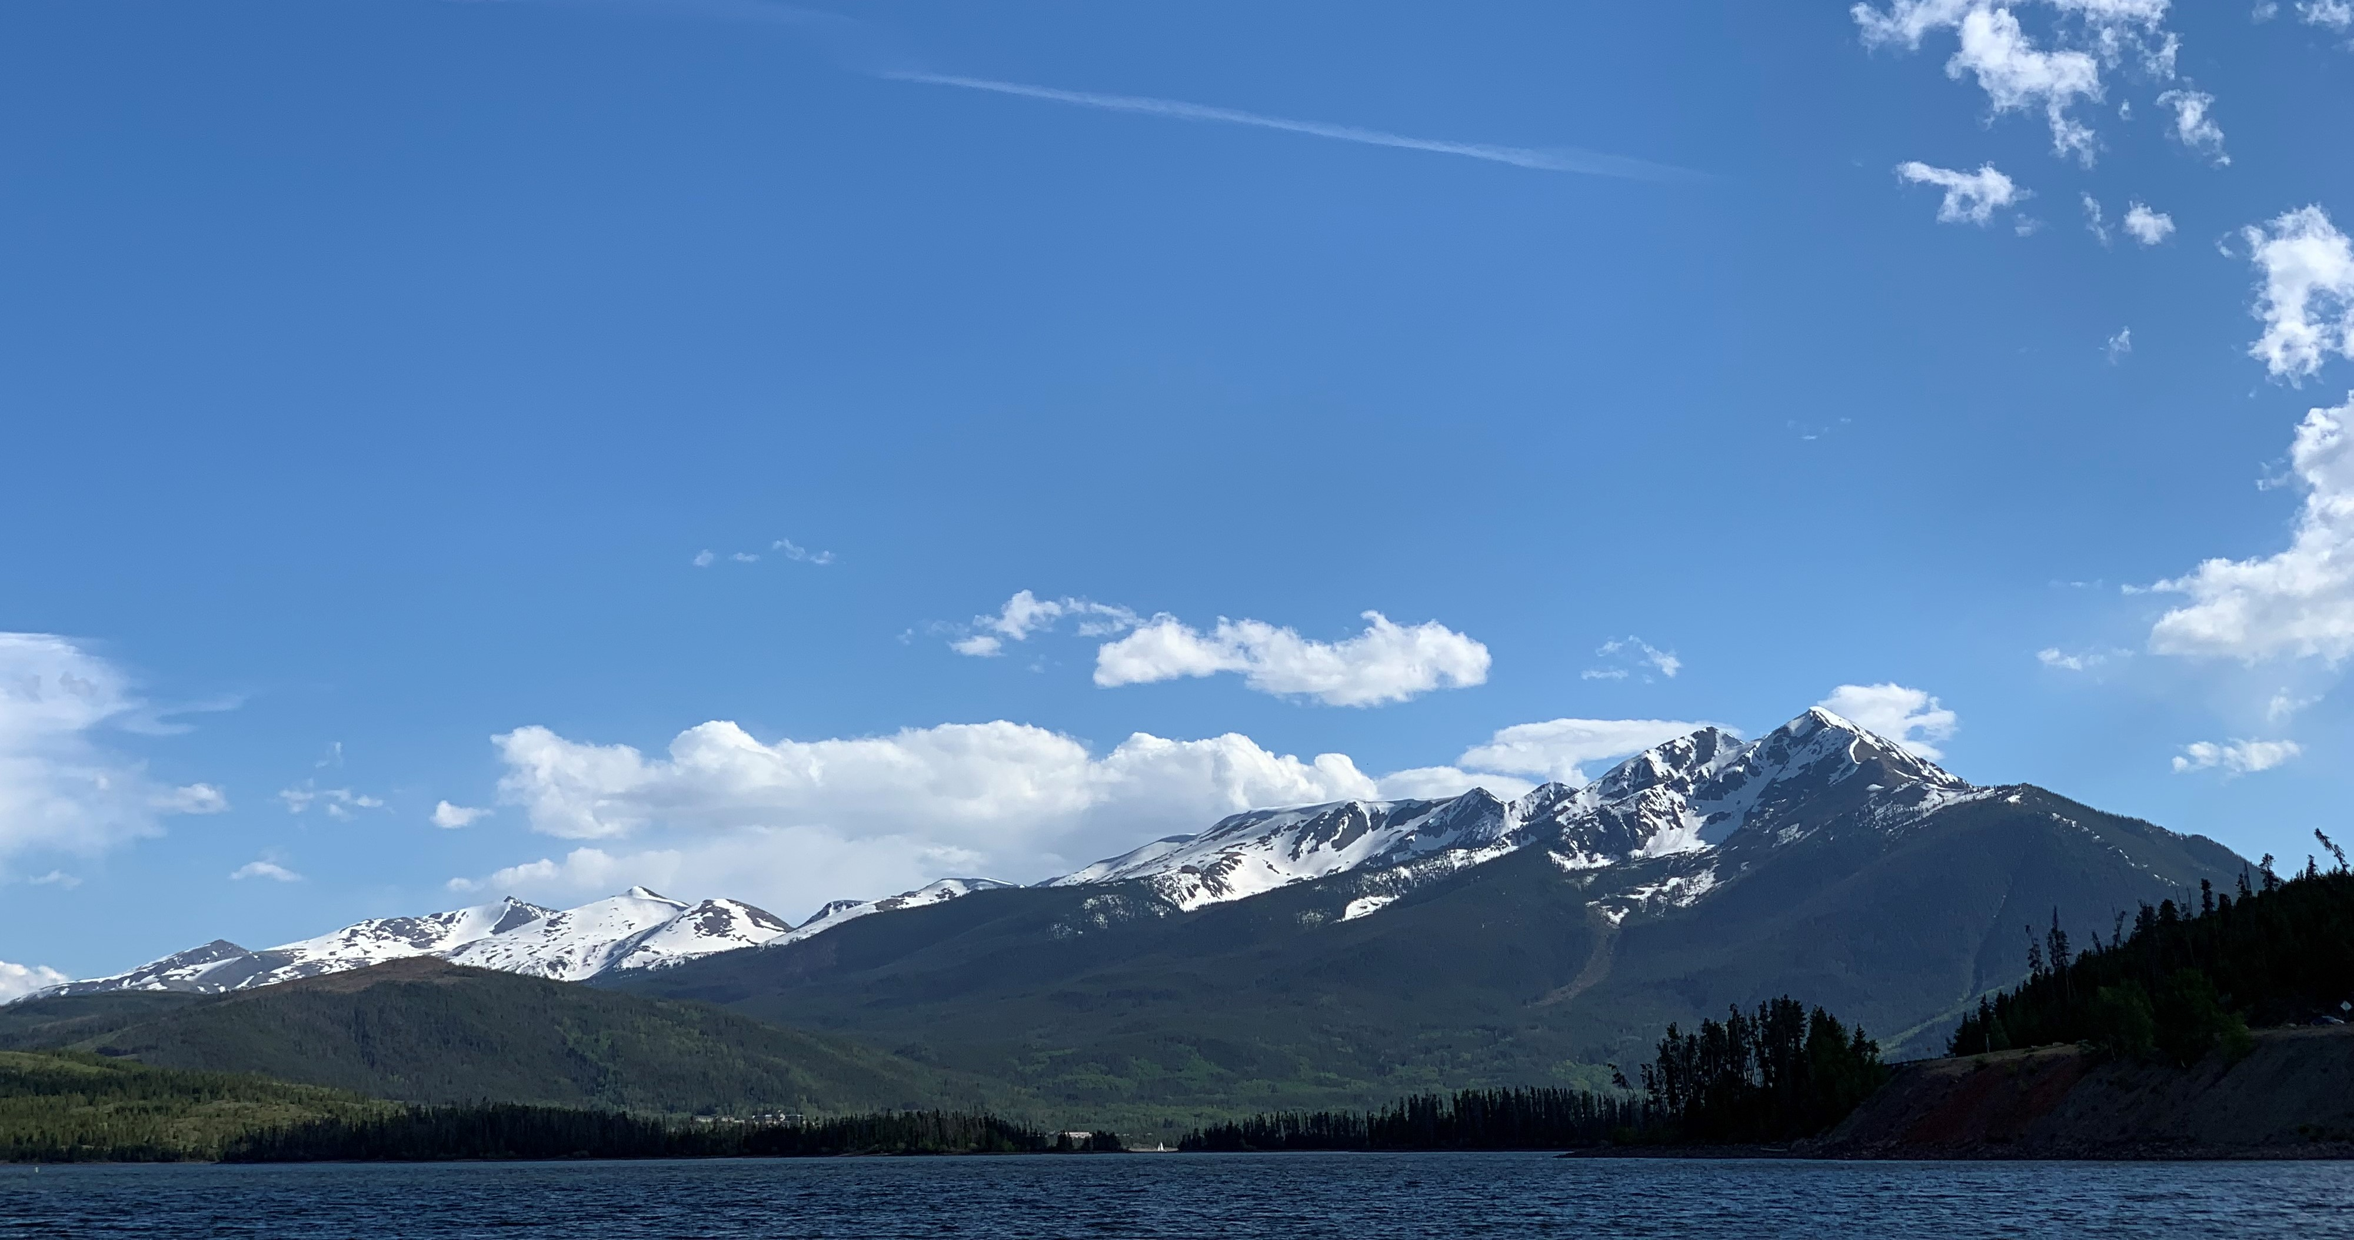
Dillon Reservoir
Blue River Work Group
August 13, 2020
Nathan Elder

Slide 2
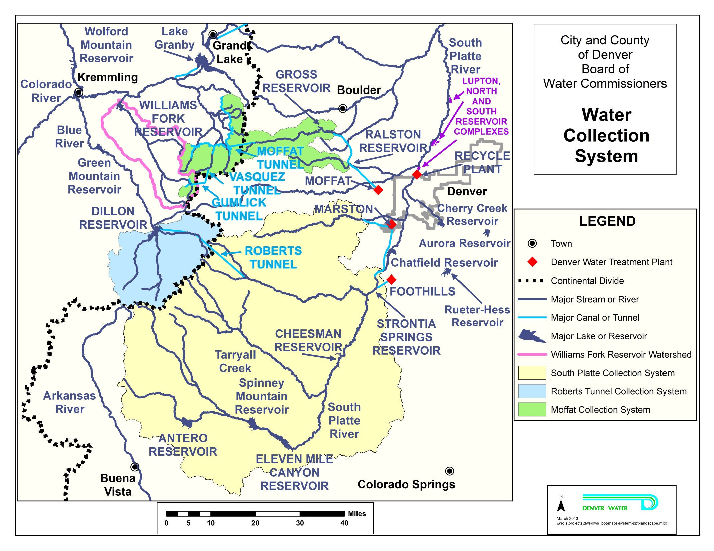
Denver Water Collection System

Slide 3
Dillon Reservoir Background
Denver Water’s Largest Storage Reservoir, 257,304 ac-ft, 37% of total capacity
Completed in 1963
Average Annual Inflow 163,000 ac-ft
Earth Fill Dam
Morning Glory Spillway
1.8 Megawatt Hydropower Plant
Roberts Tunnel
Major Recreation Facility with Two Marinas

Slide 5
Dillon Reservoir Outlet Works

Slide 6
Dillon Reservoir Outlet Works

Slide 7
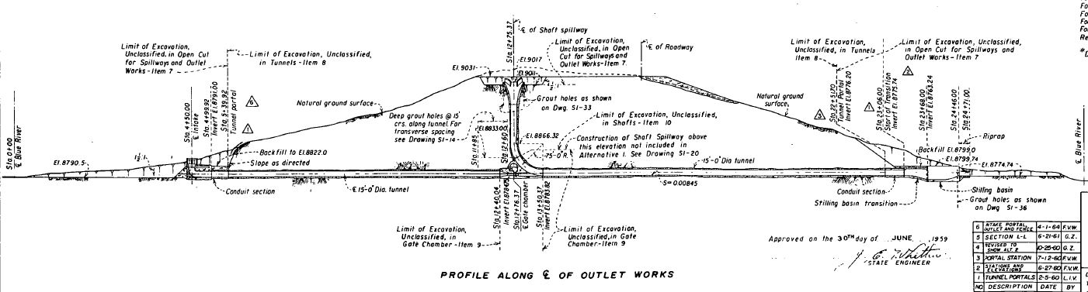
Dillon Reservoir Outlet Works
Minimum outflow 50 cfs
Power Plant max: 110 cfs
Control Valves : Can release more than 1800 cfs

Slide 8
Dillon Reservoir Outlet Works

Slide 9
Dillon Reservoir Outlet Works

Slide 10
Operations
Average Daily Inflow, cfs

Slide 11
Operations
Average Daily Reservoir Elevation, ft

Slide 12
Operations
Average Daily Outflow, cfs

Slide 13
Operations
Average Daily Roberts Tunnel Outflow, cfs

Slide 14
Operations
Average Daily Inflow v Outflow, cfs

Slide 15

Operational Goals
Fill Dillon Reservoir
Releases to Minimize High Outflows
Reservoir Elevation 9012 ft from June 18 to Labor Day for Marinas
Reservoir Outflows for Recreation Downstream
Maximize Hydropower Generation

Slide 16
Agreements
Colorado River Cooperative Agreement
  Denver Water will contribute $11 million for environmental enhancements, local water supply and water quality projects, and wastewater treatment plant projects.
  Denver Water will provide 250 acre-feet of water without charge for use in districts and towns in Summit County.
  Denver Water will use best efforts to maintain the water level of Dillon Reservoir at or above 9,012 feet in elevation between June 18 and Labor Day.
  Denver Water will provide 1,493 acre-feet of water to various Summit County water users and ski areas.
  Denver Water agrees not to exercise its existing right to reduce bypass flows from Dillon Reservoir into the Blue River during droughts to below the amount of inflow to the reservoir unless it has banned residential lawn watering in its combined service area.
  Denver Water and Summit County ski areas and towns agree to amendments to the existing 1992 Clinton Reservoir Agreement.
  Denver Water will not undertake any future water development activities without the prior approval of Summit County and the Colorado River District.

Slide 17
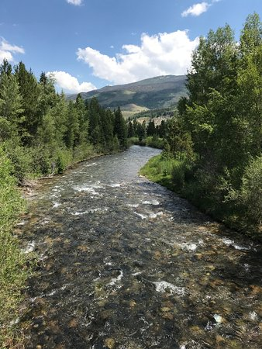
Agreements
Blue River Decree
  Dillon Reservoir and Roberts Tunnel 6/24/1946 Water Right
  Dillon Reservoir 252,678 ac-ft
  Roberts Tunnel 788 cfs
  Decreed solely for municipal purposes

Slide 18
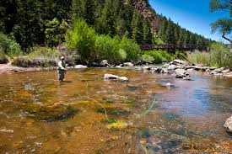
Agreements
South Platte Protection Plan
Commitments
No loss of existing or future water supply.
Minimum outflow from Spinney Mountain Reservoir – 32 cfs or inflow.
Minimum outflow from Eleven Mile Reservoir --32 cfs or inflow.
Minimum outflow from Cheesman Reservoir --35 cfs (August-March) and 40 cfs (April-July) or inflow.
Ramp outflow changes at Eleven Mile and Cheesman Reservoirs and Roberts Tunnel.
Channel work on the North Fork will maintain or enhance structural trout habitat –CDOW will be consulted.
Operators will meet each spring with fishery, whitewater, and other interests to arrange upcoming operations.
Install new equipment: low flow valve at Eleven Mile, stream temperature monitors at Eleven Mile and Cheesman Reservoirs, SNOTEL gages in watershed.
Stream Channel Maintenance and Improvement – Identify degraded stream channel areas and sedimentation sources, and develop in-stream channel improvement projects.

Slide 19

Agreements
South Platte Protection Plan
Goals
Eleven Mile Reservoir – When inflow is low make storage releases to maintain minimum outflow.
Cheesman Reservoir – When inflow is low make storage releases to maintain minimum outflow.
Operate Eleven Mile Reservoir for outflows in optimum range of 50 to 100 cfs.
Operate Cheesman Reservoir for outflows in optimum range of 50 to 150 cfs (August-March) and 100 to 225 cfs (April-July). Expect higher flow than optimum every year – natural flows exceed optimum high flows
Eleven Mile Reservoir – When reservoir is spilling, operate to discharge within optimum range of 50-60° F (June – September) with a maximum of 65° F and fluctuations no more than 10°F per day.
Cheesman Reservoir –When reservoir is spilling, operate to discharge within optimum range of 50-60° F (June –September) with a maximum of 65° F and fluctuations no more than 10°F per day. Good success at lower flows – expect less attainability at higher flows
Discharges from the Roberts Tunnel into the North Fork will consider the needs of whitewater recreation and fish habitat. Desirable whitewater streamflow is 300 to 500 cfs. Strictly contingent on water demands in Denver
Annual operating plans to emphasize limiting fluctuations when they would harm life stages of brown and rainbow trout.

